Slide 1
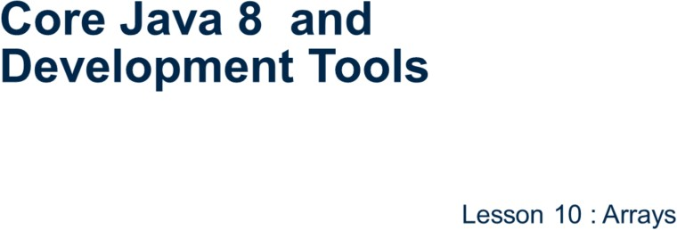
Core Java 8 and Development Tools
Arrays

Slide 2
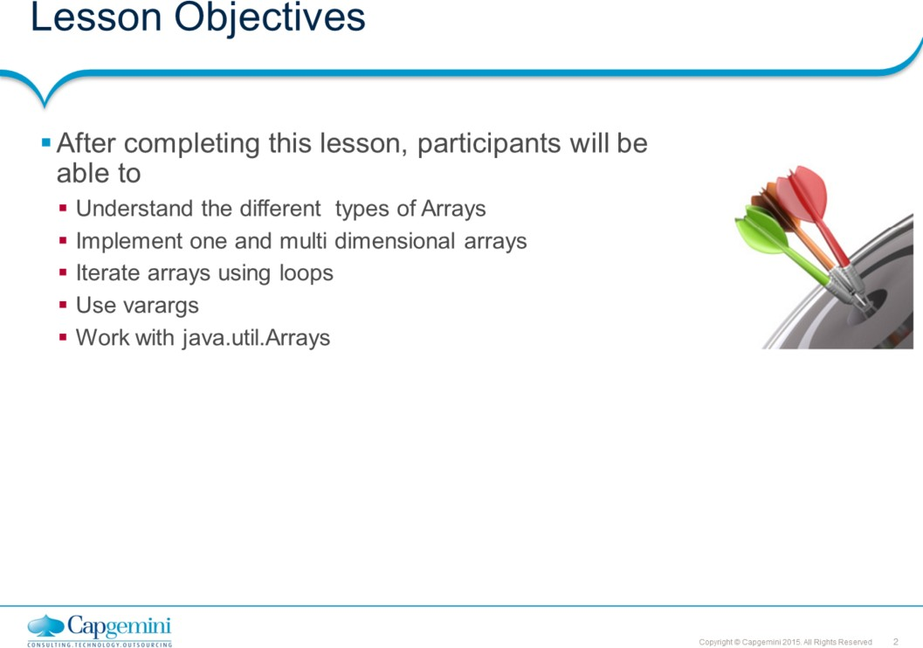
Core Java 8 and Development Tools
Arrays
This lesson discusses about how to work java arrays.
Lesson outline:
10.1: One dimensional array 10.2: Multidimensional array
10.3: Using varargs 10.4: Using Arrays class 10.5: Best Practices

Slide 3
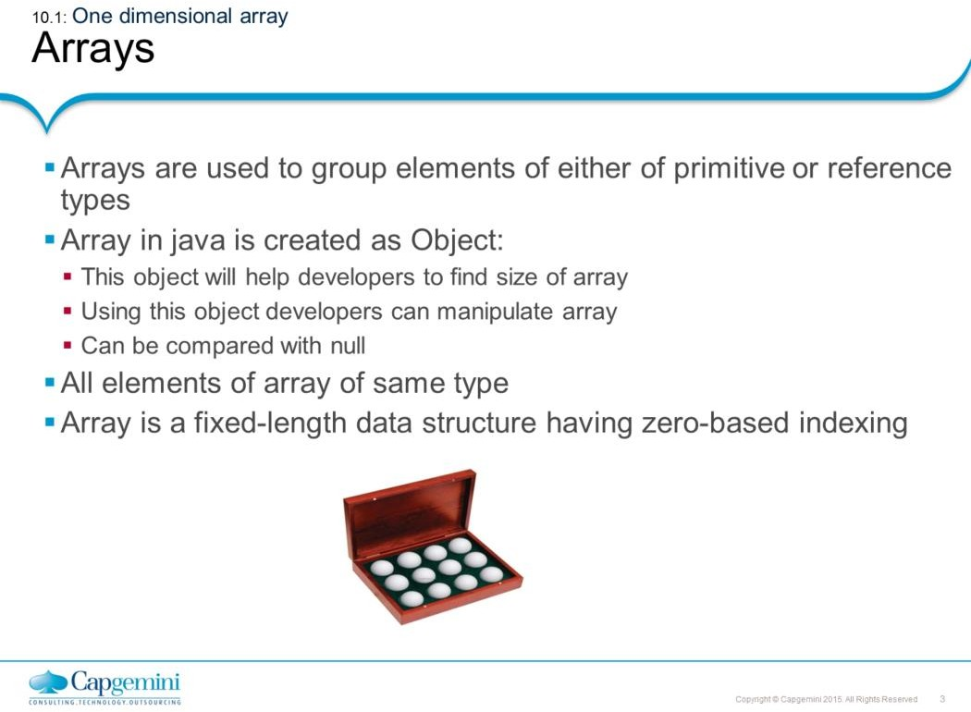
Core Java 8 and Development Tools
Arrays
Arrays can be created for either primitive or reference type elements. Array in java is created as Object using new operator. Once array is created, individual elements can be accessed using index number enclosed in square brackets.
Arrays indexing is zero based, it means the first element of array start at index 0, second element is at 1, and so on. The last element of array is indexed as one minus size of an array.
Array size can be captured by using public final instance variable called length. This
feature will avoid any runtime exceptions resulted due to out of bounds access.

Slide 4
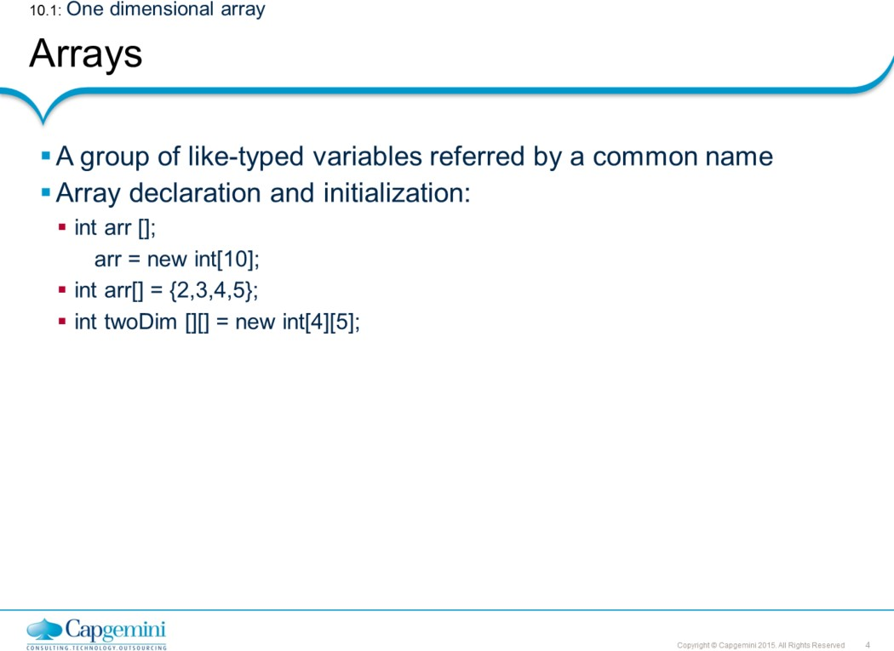
Core Java 8 and Development Tools
Arrays
Syntax wherein the array is declared and initialized in the same statement:
strWords = { "quiet", "success", "joy", "sorrow", "java" };

Slide 5
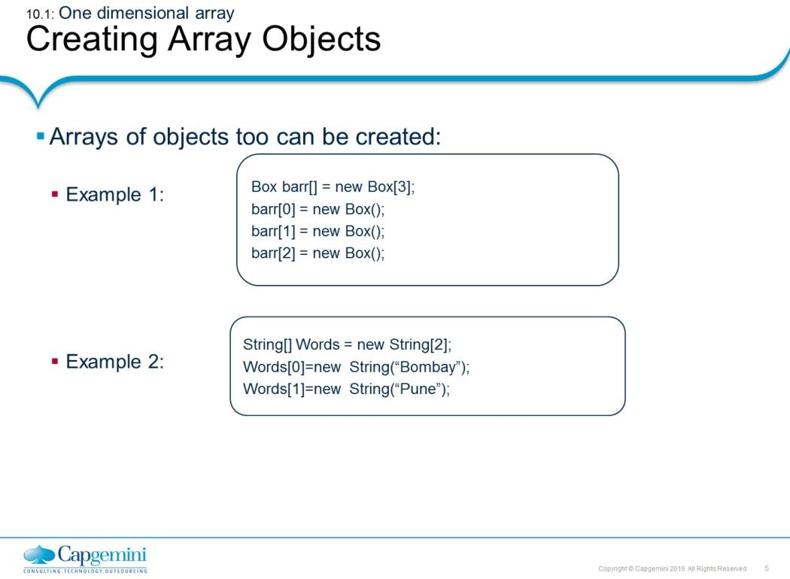
Core Java 8 and Development Tools
Arrays
Use new operator or directly initialize an array. When you create an array object using new, all its slots are initialized for you (0 for numeric arrays, false for boolean, '\0' for character arrays, and null for objects).
Like single dimensional arrays, we can form multidimensional arrays as well. Multidimensional arrays are considered as array of arrays in java and hence can have asymmetrical arrays. See an example next.

Slide 6
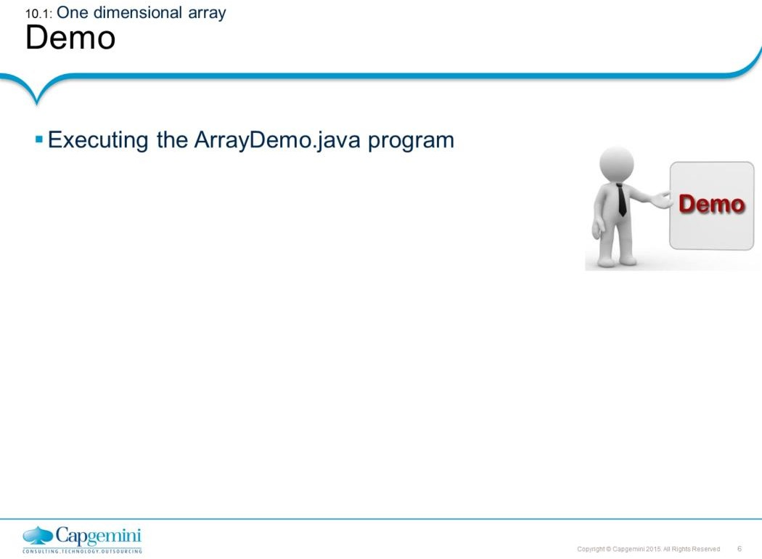
Core Java 8 and Development Tools
Arrays
We have seen how to pass parameters to program during compile time using parameter passing. One can pass parameters to a program at runtime too. The args parameter (a String array) in main() receives command line arguments.
class ArrayDemo { int intNumbers[]; ArrayDemo(int i) {
intNumbers = new int[i];
}
void populateArray() {
for(int i = 0; i < intNumbers.length; ++i) intnumbers[i] = i;
}
void displayContents() {
for(int i = 0; i <intNumbers.length; ++i) System.out.println("Number " + i + ": " + intNumbers[i]);
}
public static void main(String[] args) {
//Accepting array length as command line argument. int intArg = Integer.parseInt(args[0]);
ArrayDemo ad = new ArrayDemo(intArg); ad.displayContents();
ad.populateArray();
ad.displayContents();
} }

Slide 7
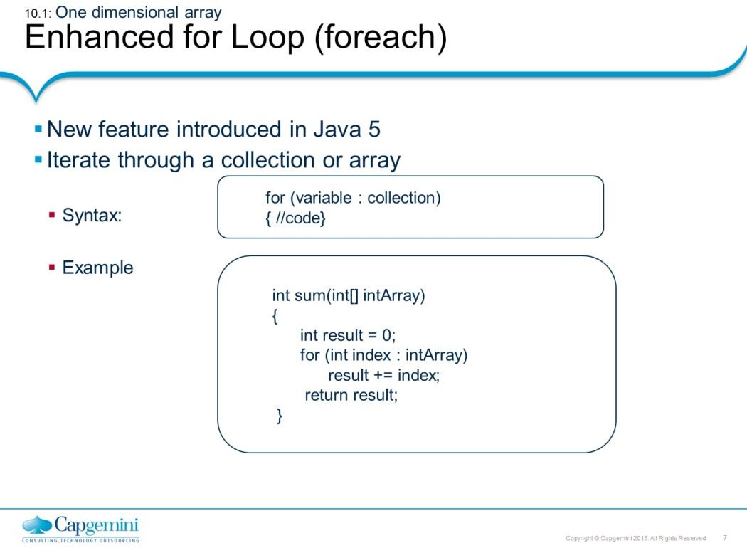
Core Java 8 and Development Tools
Arrays
Enhanced for loop works with collections and arrays. Notice the difference between the old code where the three standard steps of initialization, conditional check and re-initialization are explicitly required to be mentioned.
Old code
public class OldForArray {
public static void main(String[] args){ int[] squares = {0,1,4,9,16,25};
for (int i=0; i< squares.length; i++){
System.out.printf("%d squared is %d.\n",i, squares[i]);
}
}}
New Code
public class NewForArray {
public static void main(String[] args) { int j = 0;
int[] squares = {0, 1, 4, 9, 16, 25}; for (int i : squares) {
System.out.printf("%d squared is %d.\n", j++, i);
}
}
}

Slide 8
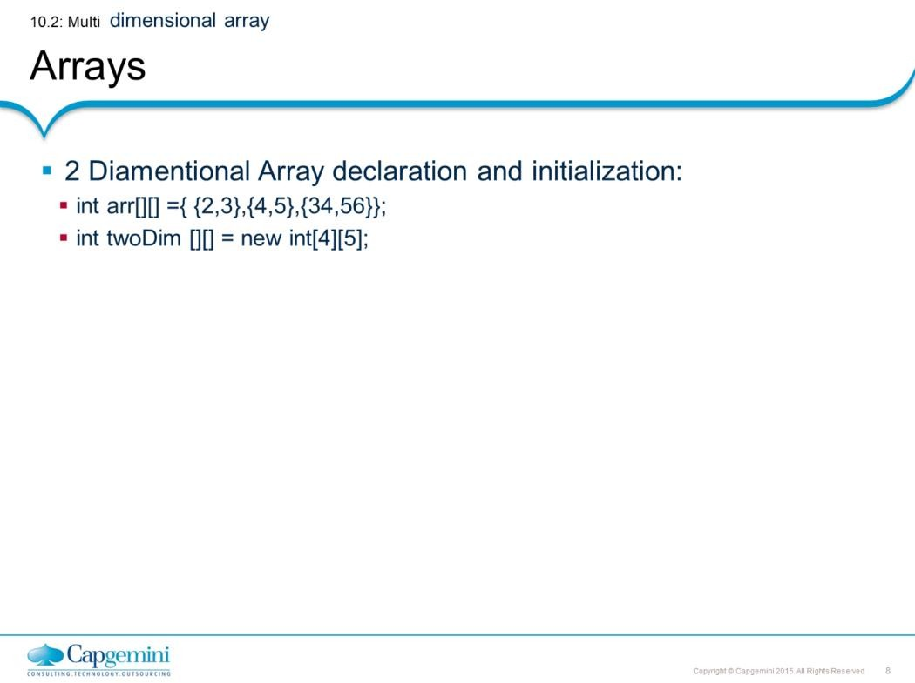
Core Java 8 and Development Tools
Arrays
Syntax wherein the array is declared and initialized in the same statement:
strWords = { "quiet", "success", "joy", "sorrow", "java" };

Slide 9
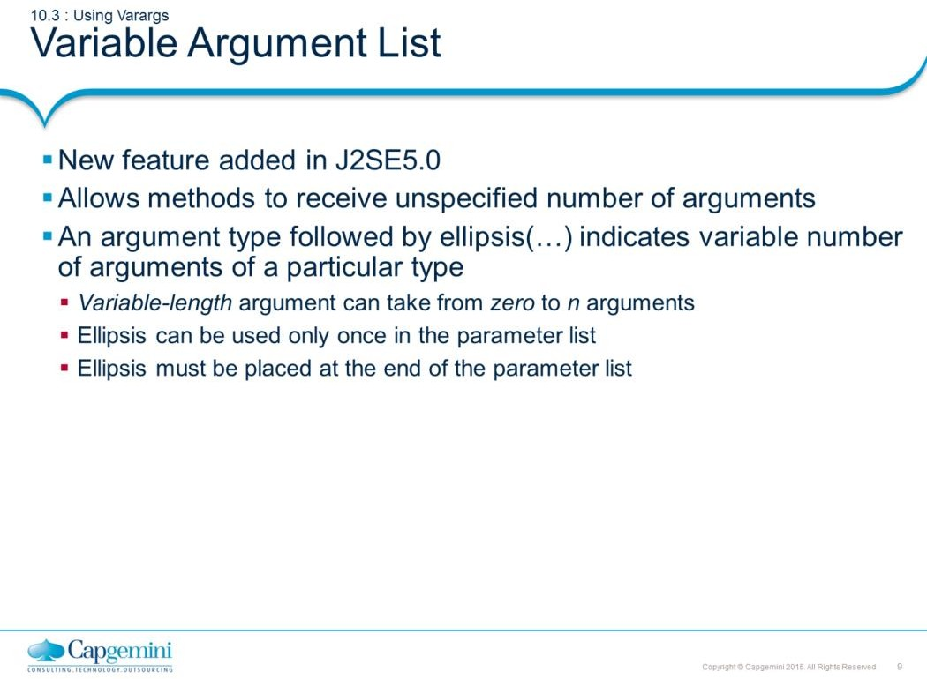
Core Java 8 and Development Tools
Arrays
J2SE5 has added a new feature that simplifies the creation of methods that need to take a variable number of arguments. This feature is called varargs and it is short for variable-length arguments.

Slide 10
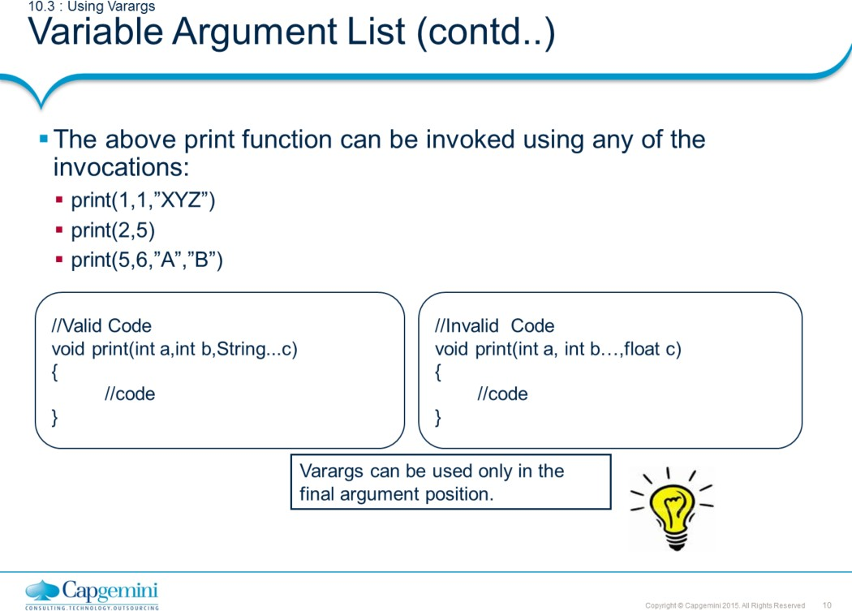
Core Java 8 and Development Tools
Arrays
Note that the ellipses (…) must come only after the last parameter. Putting it anywhere else is invalid.
The three periods indicate that the final argument may be passed as an array or as a sequence of arguments.

Slide 11
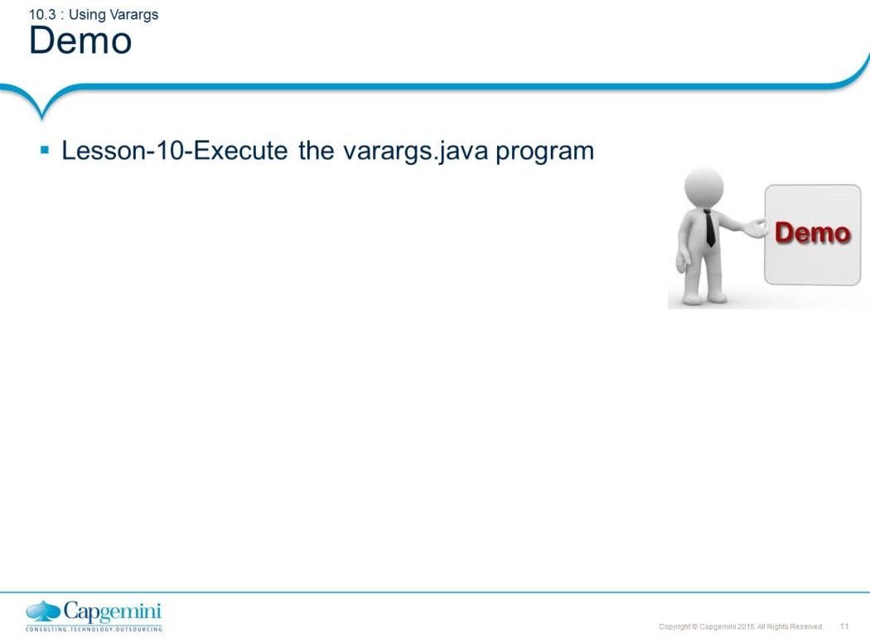
Core Java 8 and Development Tools
Arrays
import static java.lang.System.*; public class varargs {
static void print(int a,int y,String...s) { out.println(a+""+y);
for(int i=0;i<s.length;i++) out.print(s[i]+"\t"); out.println();
}
public static void main(String[] arg) { print(3,2,"java","java 5"); out.println("Next invoke"); print(1,2,"a","b","c","d","e");
} }
Java Arrays expose a property called length that returns the length of the array.
O/P:
32
java java 5 Next invoke 12
a b c d e

Slide 12
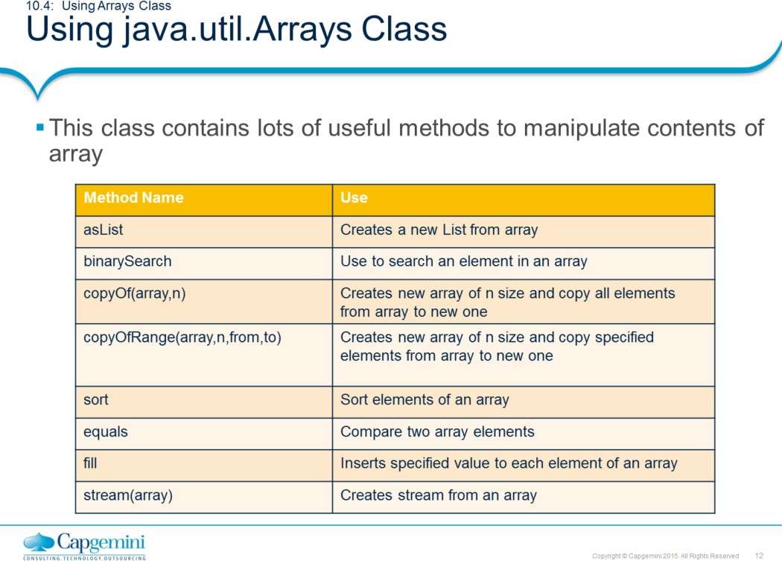
Core Java 8 and Development Tools
Arrays
Arrays Class:
Java provides utility Arrays class to manipulate arrays. This class is provided in the java.util package and includes lots of static methods to deal with array.
Please refer the java documentation of this class to know more about method signature and use.
Note: stream() method will be discussed in later chapter.

Slide 13
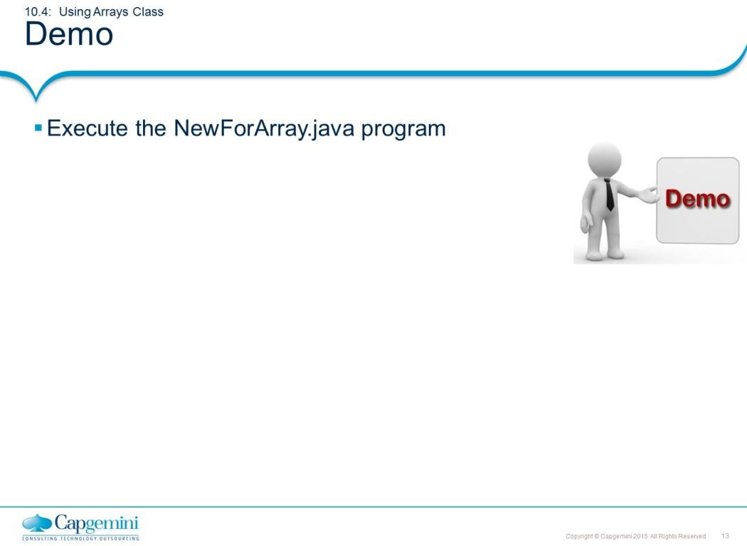
Core Java 8 and Development Tools
Arrays
import java.util.Arrays;
public class UsingArrays{ static void sort(int...s) {
Arrays.sort(s);
for(int i=0;i<s.length;i++) out.print(s[i]+“ “ ); out.println();
}
public static void main(String[] arg) { sort(15,20,42,3,56,34);
} }

Slide 14
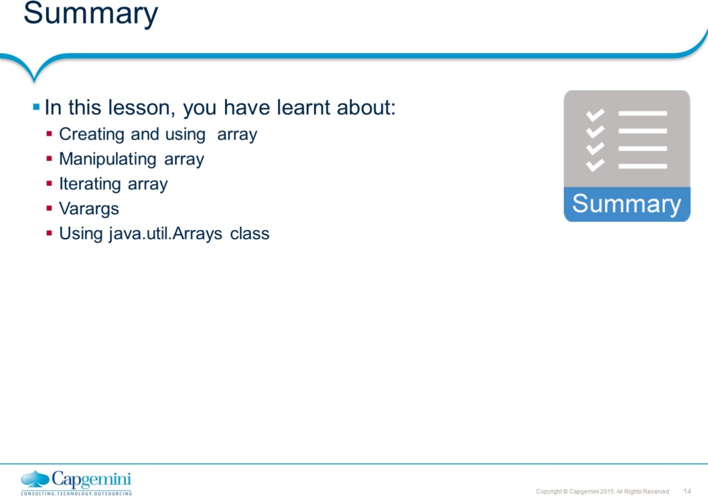
Core Java 8 and Development Tools
Arrays

Slide 15
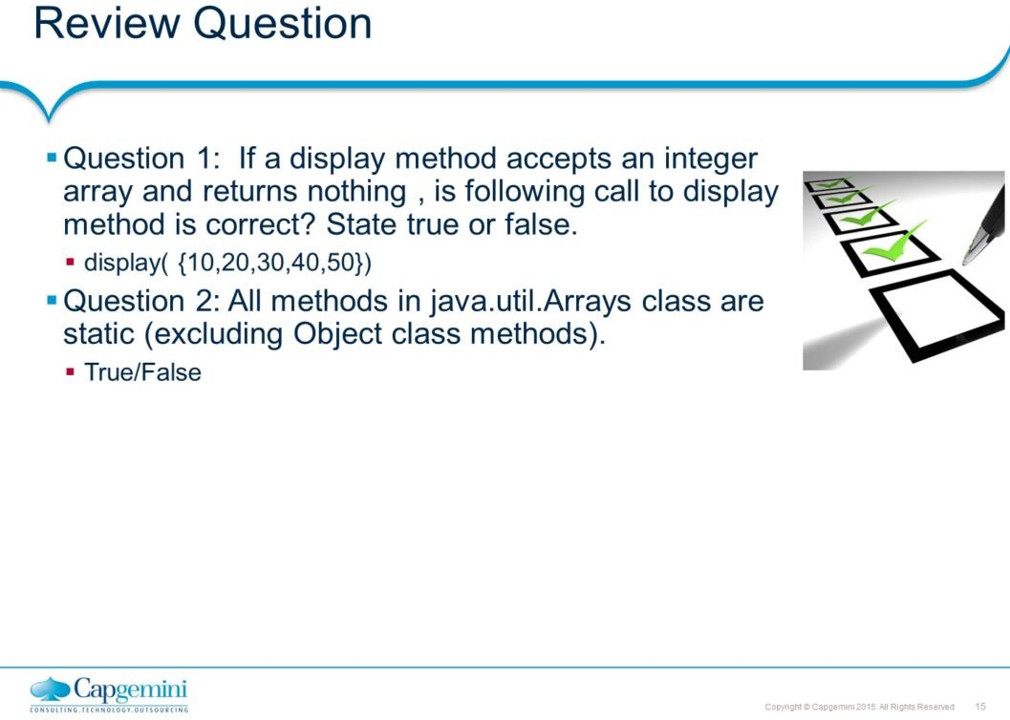
Core Java 8 and Development Tools
Arrays

